Slide 1
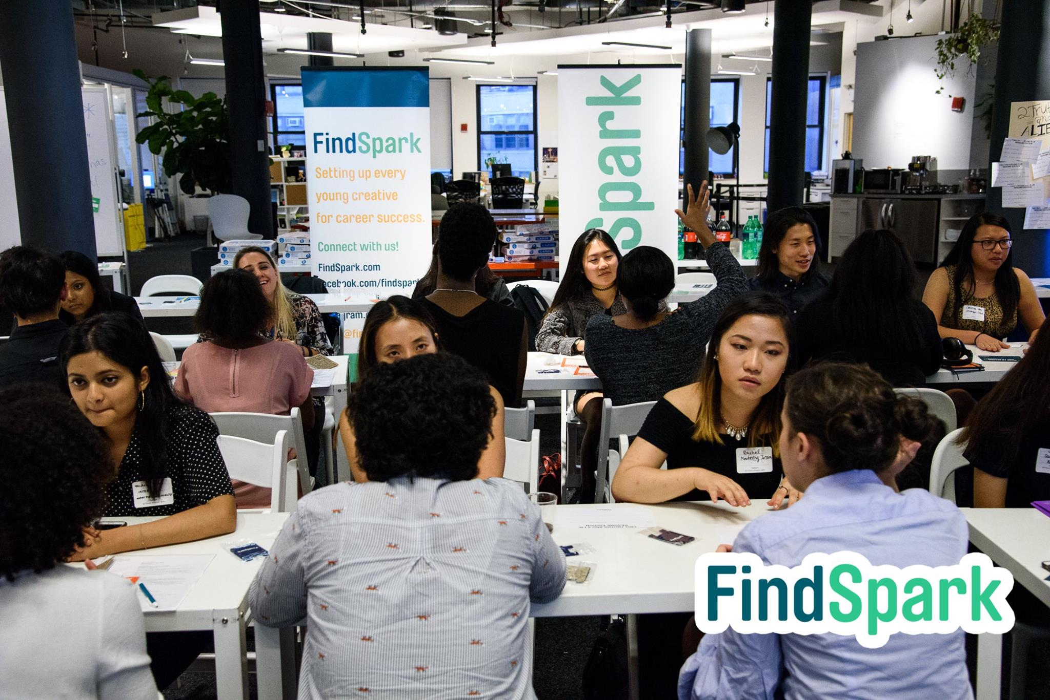
WENDY XIE
CAMPUS AMBASSADOR MARKETING PROPOSAL

Slide 2
stage 0 | SPOTLIGHT
<< MEET THE AMBASSADOR >>
WENDY XIE
SENIOR, MARKETING MANAGEMENT
BORN AND RAISED
MANHATTAN, NEW YORK
ON CAMPUS LEADERSHIP & ACTIVITIES
ASCEND BARUCH – LLP Mentor (2017 – Present)
HUMANS OF BARUCH – Social Media Manager (2016 – Present)
BARUCH UCLA – Vice President of Marketing (2016– 2017)
WHY DID I JOIN #FINDSPARK?
TO GROW WITH LIKE-MINDED INDIVIDUALS
FOR BETTER OPPORTUNITIES
WWW.WENDYXIE.COM

Slide 3
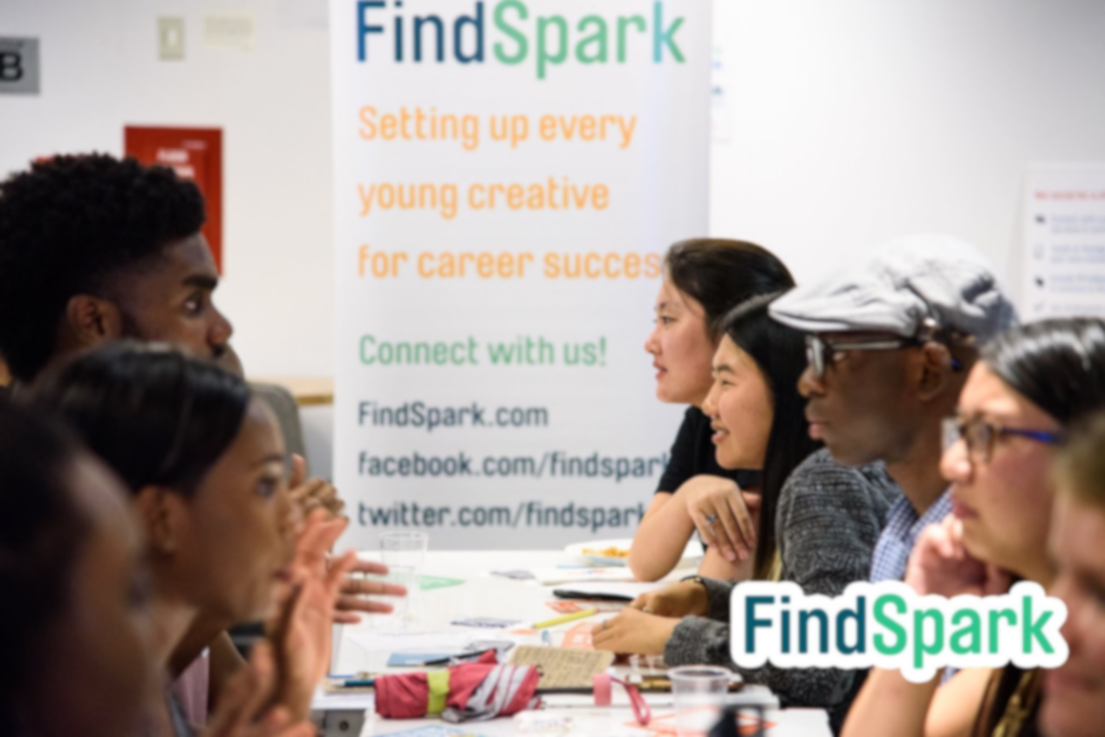
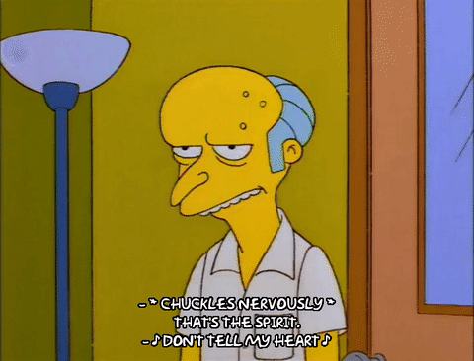
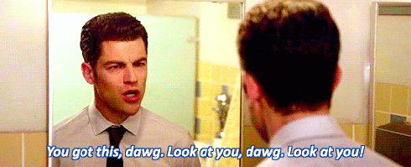
stage 1| self-reflect
Where do you see yourself going?
Are you struggling to find your first stop to success?
Are you on the endless hunt to land your dream job?
How do you exactly secure your future?
INEVITABLE: We are always fronting while struggling to find stability
NOW: It’s time you take control of your outcome, define your success
Choose the best transition for yourself – Growth to Maturity
Make your next career move with FindSpark

Slide 4
stage 2| set goals
PERSONAL GROWTH
STEPS TO SUCCESS
DEVELOP BRANDING STRATEGY
INDUSTRY INSIGHTS & KNOWLEDGE
NETWORK WITH PROFESSIONALS
FIND YOUR SPARK WITHIN A COMMUNITY OF HUSTLERS

Slide 5
stage 3| START SMART
With FindSpark
Quick Stats
250+ Career Programs
25,000+ Members
500+ Schools Repped
_________________________
Membership Perks
Gain Lifelong Community
Guaranteed Referrals
Internship Search Engine
Experience Points
Optimize Job Opportunities
Total Cost : FREE
Sample Established Network

Slide 6
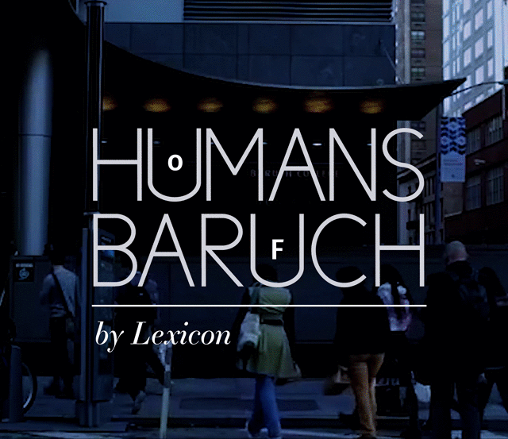
stage 4| strategy
Event Ideas and Potential Workshops to expand Findspark
Business Insider – Sharing Industry Knowledge ft. Ascend Baruch
Why Marketers make the most inspirational leaders ft. Ascend Baruch
Find Your Spark – How to no longer feel lost in College ft. Ascend Baruch
Distinguish Yourself with Personal Branding ft. Ascend Baruch
Cultural Club Experience to Career in Entertainment ft. Baruch UCLA
How to think Fashion-Forward in the Digital Universe ft. Baruch UCLA
How changing a brand’s perception can make you successful ft. Baruch UCLA
Sponsor Baruch UCLA annual cultural festivals (provide merch and info packet)
Master your Emotional Intelligence on Interviews ft. Humans of Baruch
Personal v. Professional Interviews ft. Humans of Baruch
The Truth Behind Behavioral Interviews [Recruiters Review] ft. Humans of Baruch
Mastering Storytelling with Solid Strategy ft. Humans of Baruch

Slide 7
stage 5| social media
Video Series - Ambassador Talks
Infographic on Personal Branding Tips
Video advertisement introducing Findspark as job search engine
Post and tag people who attended group event photos
Video Series – Business Insights and College Ambassador experience
Promotional Video Clips on Upcoming Events and Workshops
Instagram Live Story Takeover
Gallery – Professional Tips
Design own Snapchat Filter to cater for special events
Vertical video series – Findspark members talk about buttoning up
Quote of the Day – Daily feed
Share vertical event flyers on story
Relatable Work Memes of the Day
Blog Topics
How to lead awkward interviews towards your advantage
How to properly approach the recruiter of your dream jobs
Life Hacks you need to know when you’re 21

Slide 8
stage 6| summit
Epic Career Fair – Sneak a Peak
Connecting Hustlers to Recruiters of your Dream Job
Collecting Relationships, not Business Cards
More info: http://www.hustlesummit.co
More on FindSpark:
Host free virtual professional workshops [Members Exclusive]
Snapchat Takeovers / Facebook Live ft. Guest Speakers/Appearances
Wix Lounge professional workshops ft. Corporate Representatives
Professional Blogs & Weekly Opportunities Newsletter
More Info: https://www.findspark.com/#sign_up

Slide 9
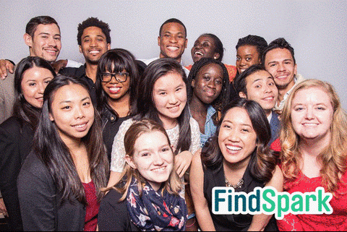
END STAGE| Succeed
LIFE HACKS TO LIVE BY
Anyone can copy your work but they can never replicate your talent.
You have a lot to offer, more than even you know.
The more you know, the more you grow.
Ask questions, you get answers.
Opportunities are out there, you just got to work for it.
It’s what you do in the dark that puts you in the light.
Success is essentially finding happiness in the little moments that matter big time.
You aren’t defined by your last success any longer than you are defined by your last failure.
FIND YOUR SPARK

Slide 10
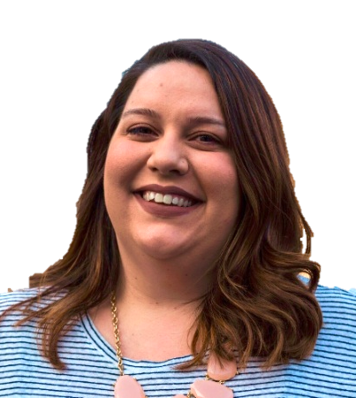
SPECIAL THANKS
SPARK HERE
EMILY MIETHNER
CEO AND FOUNDER OF FINDSPARK
E: emily@findspark.com
MARIE DELAGE
DIRECTOR OF COMMUNITY AND PARTNERSHIPS OF FINDSPARK
E: marie@findspark.com

